Slide 1
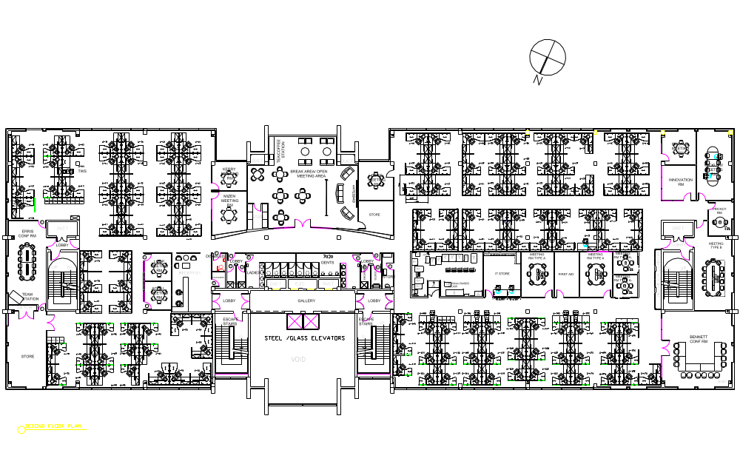
Dromore House – 2nd Floor
Conference Rooms Locator
Kinsale
Mizen
Hook
Wicklow
Kerry
Library
Derg
Galley
Dunmore
L
Bray
Brandon
Carnsore
Loop
Howth
Achill
Erris
Bennett

